Slide 1
Doorstep
SE Sprint 3
UM1
PM: Austin Do & David Martinez
SM: Kayhan Kishi & Oluwanifemi Owolabi
Programmers: Alexandra Ochoa & Hyunki Lee

Slide 2
What is DoorStep?
Doorstep is an application that allows the user to order groceries from the comfort of their homes and have it delivered straight to their home by a courier that can be tracked live.

Slide 3
Purpose & Audience
The purpose of DoorStep is to get groceries to those who are at risk for sickness or those who have mobility issues and unable to get groceries for themselves.
Audience: Everyone, but mostly those who are at risk for sickness, lower mobility, and concerned with their health.

Slide 4
Goal
The overall goal of DoorStep is to increase grocery sales while lowering the amount of traffic in grocery stores.

Slide 5
Technologies
Platforms: Google Play Services
Libraries: Firebase and SquareUp Picasso
Emulators: Android 11.0 API 30

Slide 6
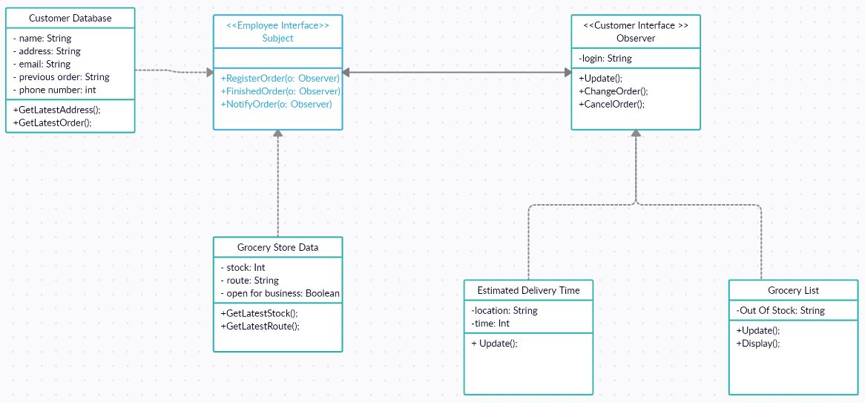
System Diagram

Slide 7
Demonstration

Slide 8
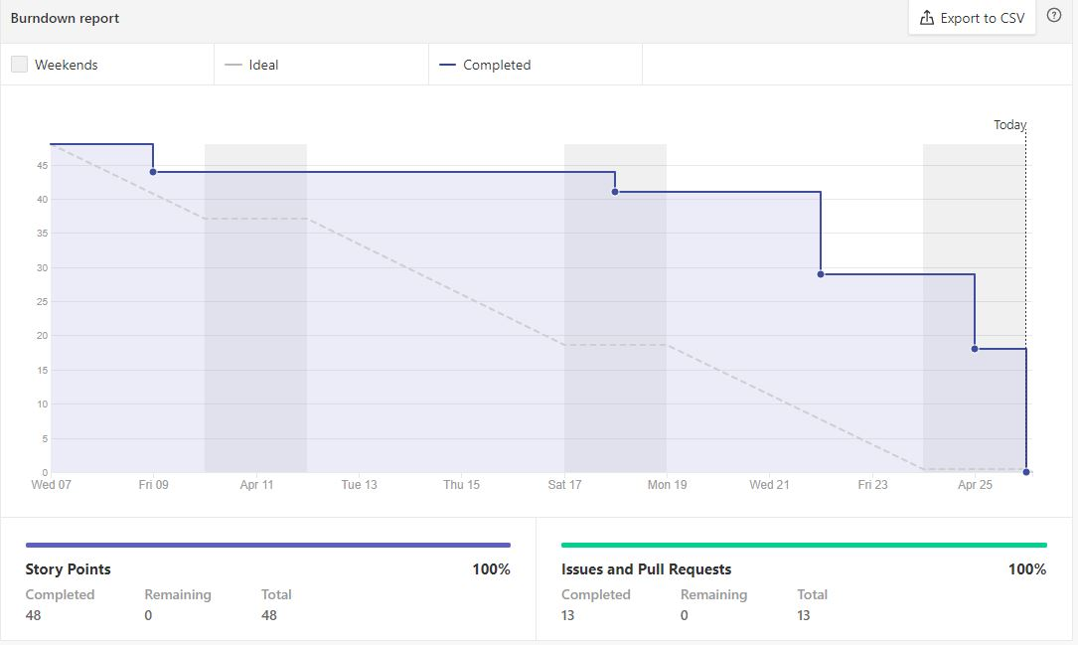
Burn-down Chart

Slide 9
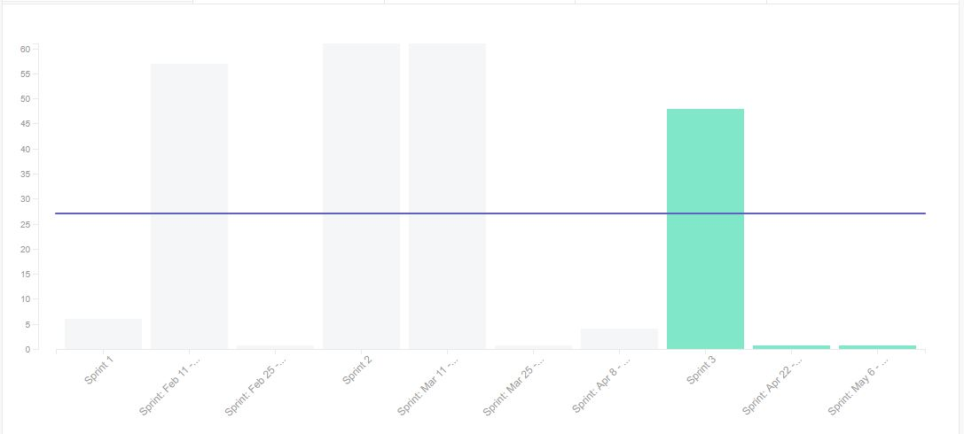
Velocity Chart

Slide 10
Issues
Discuss any issues not completed in an epic
Mapping issues not solved in time
Development Setbacks:
Keeping track of the layouts, check to see every text is a string resource. Making sure neither of them have the same value or text. Also, Making sure we don’t get the layouts mix up with each other. (Happened a few times)
Bugs?
Login Logout bugs

Slide 11
Roadblocks & Setbacks
Describe technology roadblocks, development setbacks, team collaboration problems
Group members bogged down by other assignments setback production
Long periods of radio silence negatively affected collaboration
Notes:
Yes

